Slide 1

Microprocessor System Design Grade finder using ID

Slide 2




Our team
Marwan Essam
Farida Yasser
Hisham Ahmed
Mosaab Emad
202000417
202000177
202001462
202000092

Slide 3

Table of contents
01
02
03
04
Introduction
Methdology
Code explanation
Conclusion

Slide 4

01
Introduction

Slide 5
Introduction
This project presents an x86 assembly language program that interfaces with LCD and processes user input from a keypad. The program begins with an initialization phase, configuring input/output ports and initializing the LCD.
The main program loop engages the user to input an ID from 1 to 9 using a keypad.
The code effectively handles keypad inputs, displaying corresponding information on the LCD screen. Subroutines manage LCD initialization, command execution, and character/string writing.

Slide 6
02
Methodology

Slide 7
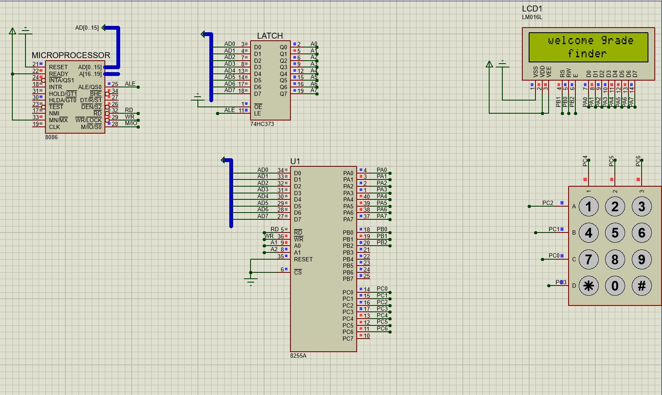
Methodology
This x86 assembly code is designed for interfacing with an LCD and processing input from a keypad.
The program initializes ports, configures the LCD, and interacts with the user through the keypad to display information on the LCD screen.

Slide 8
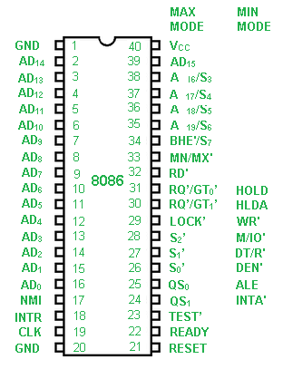
8086
The 8086 microprocessor is a 16-bit architecture that enables efficient data processing, allowing the microprocessor to handle the input from the keypad and perform the necessary calculations and operations to determine and display the grades on the LCD.

Slide 9
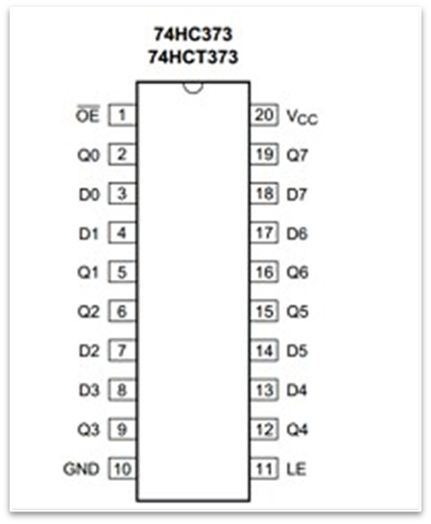
74HC373
The 74HC373 latch can be utilized as an integral component. The 74HC373 is a latch or flip-flop integrated circuit that provides temporary data storage capabilities. In this context, the 74HC373 can be employed as a buffer between the keypad and the microprocessor.

Slide 10
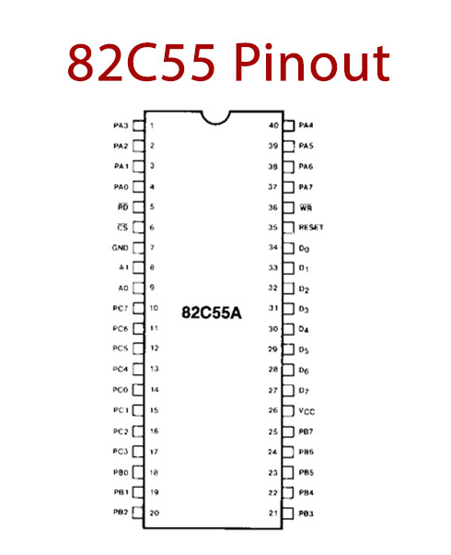
The 82C55 microprocessor is a Programmable Peripheral Interface integrated circuit that serves as an I/O interface device, specifically designed for interfacing a microprocessor with peripheral devices.
The 82C55 acts as a bridge between the microprocessor and the keypad, enabling the microprocessor to receive input from the keypad and process it.

Slide 11
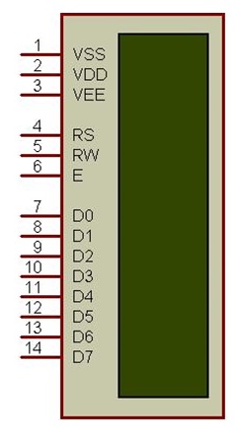
LCD Liquid crystal display
The LCD is providing a visual interface for displaying the calculated grades or other relevant information to the user. It typically consists of multiple segments or pixels that can be individually controlled to form characters, numbers, or graphical elements.

Slide 12
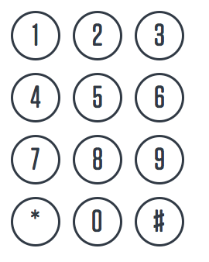
Keypad
The keypad allows users to input data, such as grades or other relevant information, into the system. The keypad is typically composed of individual buttons, each representing a specific digit or function.
When a user wants to input a grade, they press the corresponding buttons on the keypad, which generate electrical signals. These signals are then processed by the microprocessor, which interprets the input and performs the necessary calculations to determine the grades.

Slide 13
03
Code explanation

Slide 14
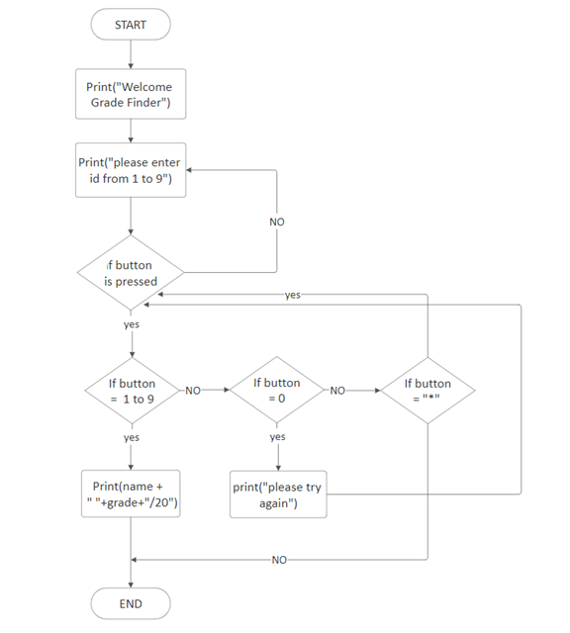
Flow chart
START
Initialization
Main Program Loop
Keypad Input Processing
Button Pressed Analysis
Invalid Input Handling
Reset or Continue
Input Processing
Display Result
Loop Back
END

Slide 15
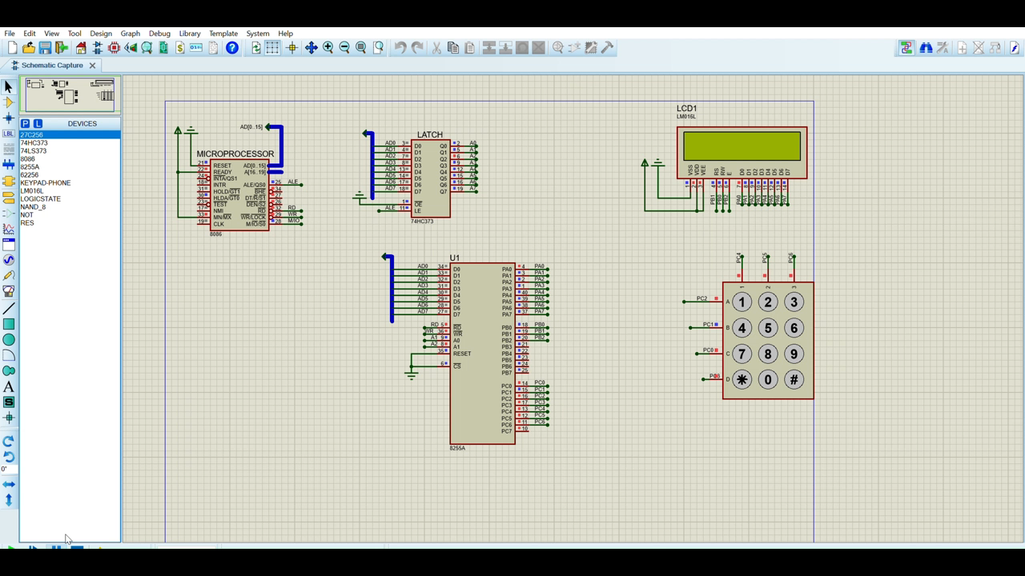
SIMULATION VIDEO

Slide 16
04
Conclusion

Slide 17
Conclusion
In conclusion, the x86 assembly code presented in this project successfully implements an interface between a microcontroller and a Liquid Crystal Display (LCD), incorporating keypad input functionality. The program demonstrates effective utilization of assembly language instructions to configure ports, initialize the LCD, and process user input through a keypad.
The main program loop engages the user by prompting them to input an ID from 1 to 9 using the keypad. Keypad input is efficiently processed, allowing the program to display corresponding information on the LCD screen. The code employs subroutines for LCD initialization, command execution, and character/string writing, enhancing code modularity and readability.

Slide 18

Thanks!
Any questions!

